Slide 1
R Data Clinic
Robbie Richards & Kate Sabey
November 7, 2020

Slide 2
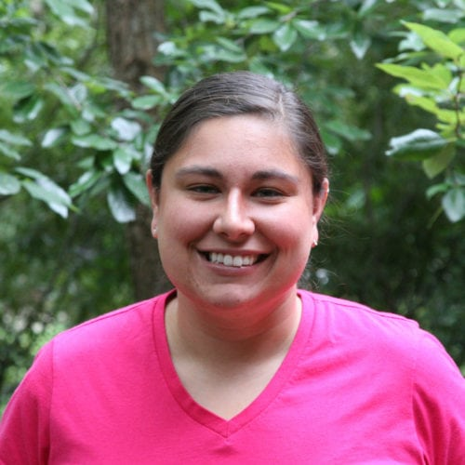
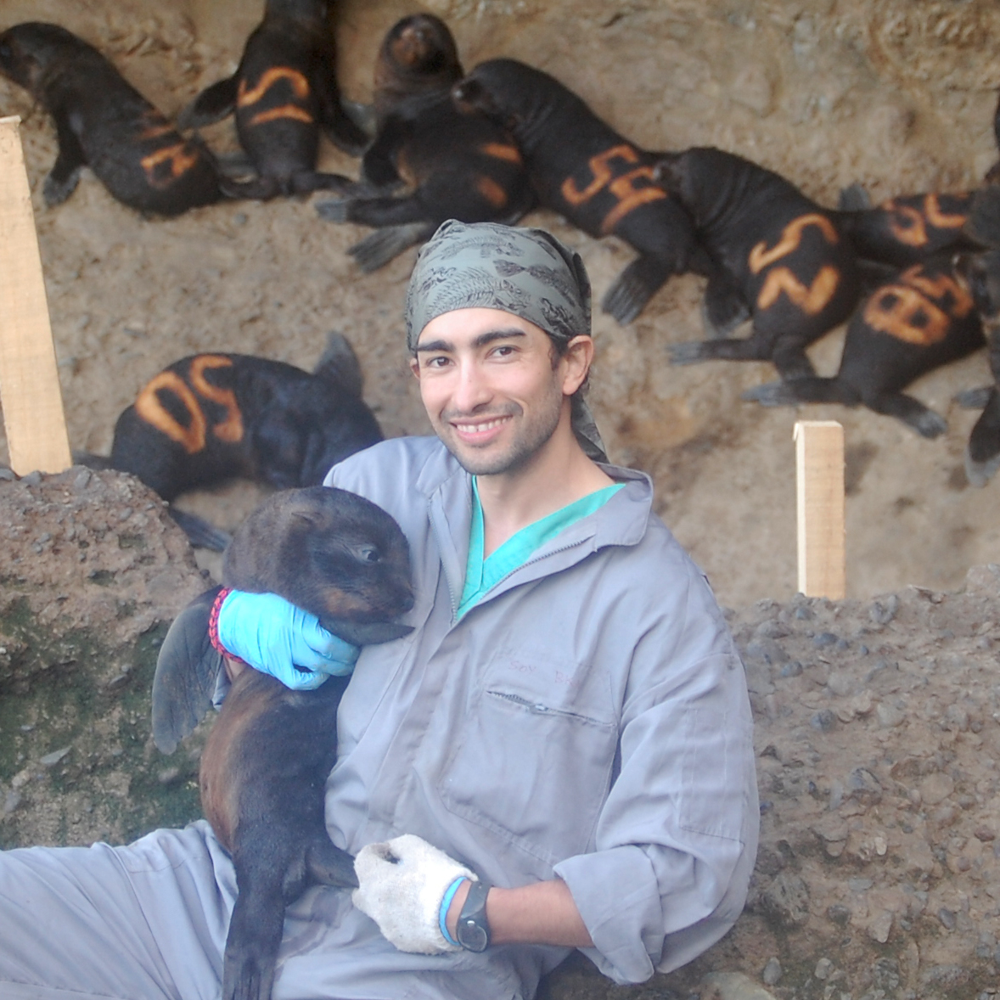

Brought to you by:
Dr. Ana Bento
Assistant Professor
Indiana University
Dr. Mauricio Seguel
Assistant Professor
University of Guelph
RajReni Kaul
PhD Candidate
University of Georgia

Slide 3


Brought to you by:
Kate Sabey
PhD Candidate
Infectious Diseases
Robbie Richards
PhD Candidate
Odum School of Ecology

Slide 4
What is R?

Slide 5
R is a language and environment for statistical computing and graphics
Notes:
When I mention CRAN I will say this: is a network of ftp and web servers that store identical, up-to-date, versions of code and documentation and packages for R.
1

Slide 6
R is a language and environment for statistical computing and graphics
The official R home page: http://www.R-project.org
Notes:
When I mention CRAN I will say this: is a network of ftp and web servers that store identical, up-to-date, versions of code and documentation and packages for R.
1

Slide 7
R is a language and environment for statistical computing and graphics
The official R home page: http://www.R-project.org
You download it from CRAN: https://cran.r-project.org/
Notes:
When I mention CRAN I will say this: is a network of ftp and web servers that store identical, up-to-date, versions of code and documentation and packages for R.
1

Slide 8
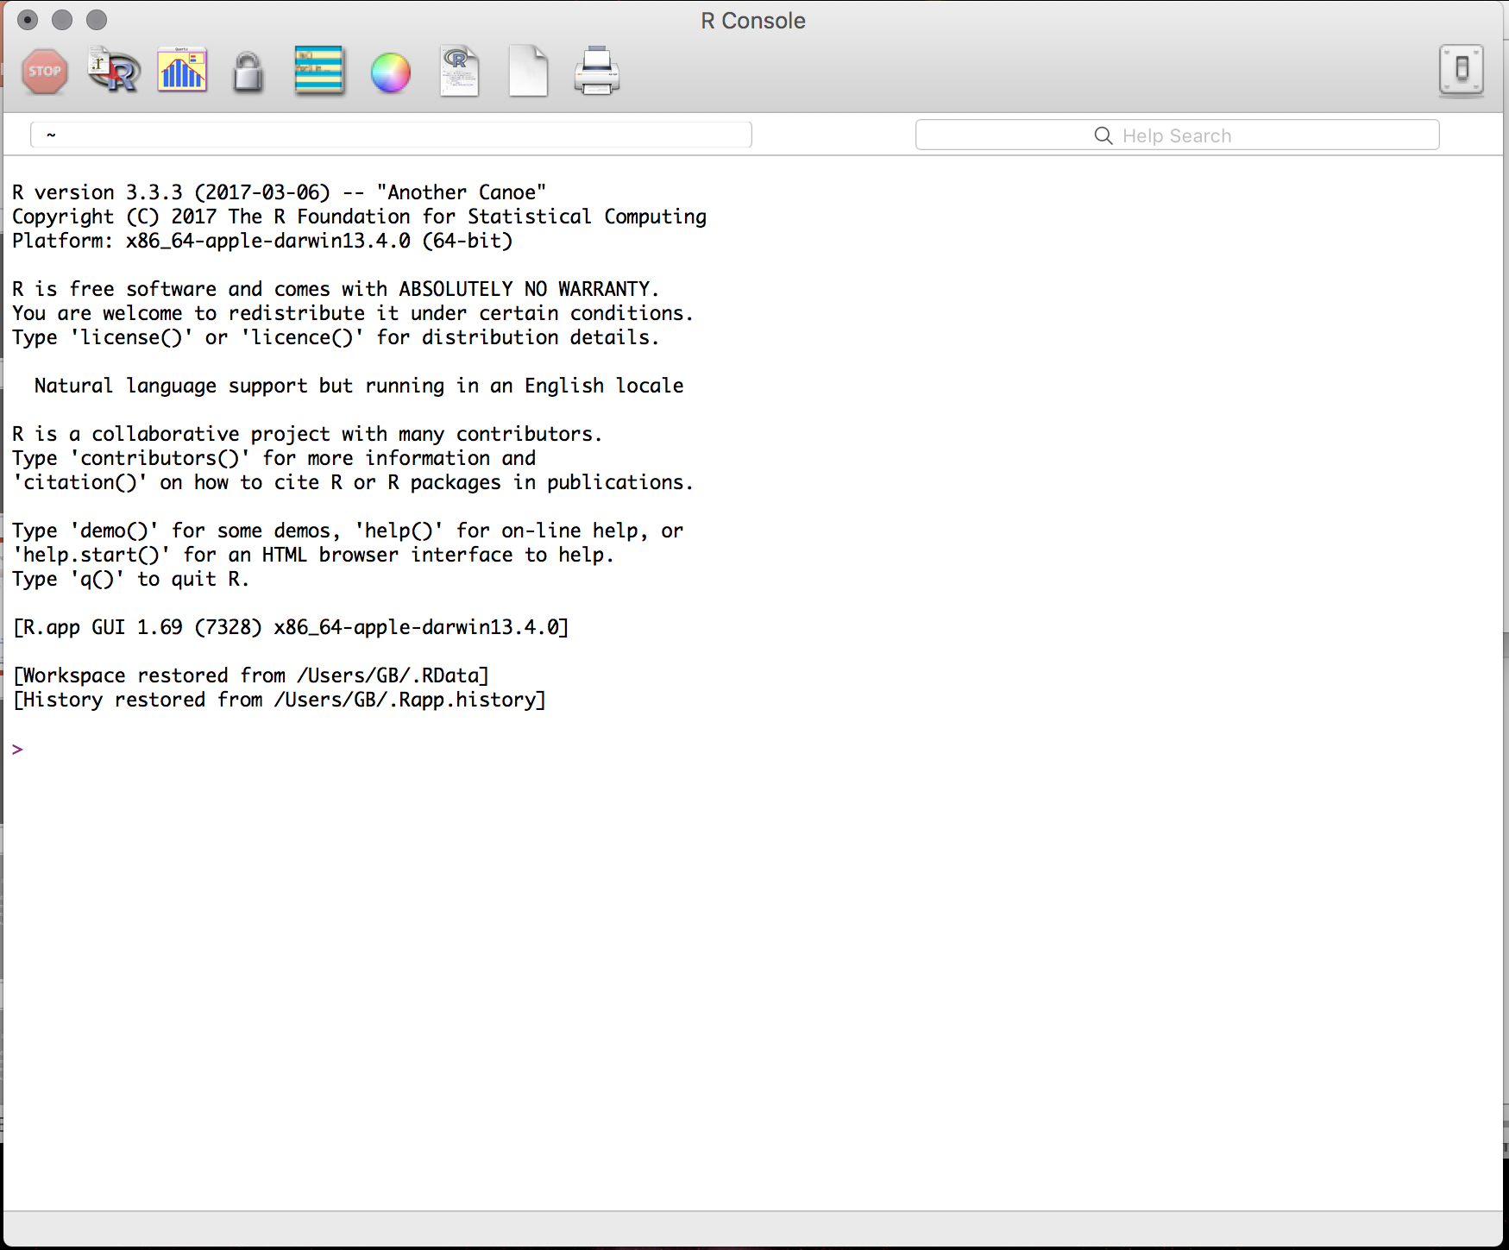
R is a language and environment for statistical computing and graphics
The official R home page: http://www.R-project.org
You download it from CRAN: https://cran.r-project.org/
The R system can be installed on, Windows, Mac or Linux
Notes:
When I mention CRAN I will say this: is a network of ftp and web servers that store identical, up-to-date, versions of code and documentation and packages for R.
1

Slide 9
Why R?

Slide 10
It’s free
Notes:
It's free!
Popularity -- we can show published papers with plots
Awesome power
can handle complex and large data
can easily program complex simulations
can be used on High Performance Computer Clusters * supports multicore task distribution* Flexibility* Great support * Packages vignettes, tutorials, free books * StackOverflow * R-Bloggers
1

Slide 11
It’s free
Popularity
Notes:
It's free!
Popularity -- we can show published papers with plots
Awesome power
can handle complex and large data
can easily program complex simulations
can be used on High Performance Computer Clusters * supports multicore task distribution* Flexibility* Great support * Packages vignettes, tutorials, free books * StackOverflow * R-Bloggers
1

Slide 12
It’s free
Popularity
Awesome power: can handle complex and large data
can easily program complex simulations
can be used on High Performance Computer Clusters
supports multicore task distribution
Notes:
It's free!
Popularity -- we can show published papers with plots
Awesome power
can handle complex and large data
can easily program complex simulations
can be used on High Performance Computer Clusters * supports multicore task distribution* Flexibility* Great support * Packages vignettes, tutorials, free books * StackOverflow * R-Bloggers
1

Slide 13
It’s free
Popularity
Awesome power: can handle complex and large data
can easily program complex simulations
can be used on High Performance Computer Clusters
supports multicore task distribution
Flexibility
Notes:
It's free!
Popularity -- we can show published papers with plots
Awesome power
can handle complex and large data
can easily program complex simulations
can be used on High Performance Computer Clusters * supports multicore task distribution* Flexibility* Great support * Packages vignettes, tutorials, free books * StackOverflow * R-Bloggers
1

Slide 14
It’s free
Popularity
Awesome power: can handle complex and large data
can easily program complex simulations
can be used on High Performance Computer Clusters
supports multicore task distribution
Flexibility
Great support: Packages; vignettes; tutorials; free books; google
StackOverflow; Rbloggers my two personal favorites!
Notes:
1

Slide 15
R Studio

Slide 16
Using R is easier with RStudio
Notes:
It's free!
Popularity -- we can show published papers with plots
Awesome power
can handle complex and large data
can easily program complex simulations
can be used on High Performance Computer Clusters * supports multicore task distribution* Flexibility* Great support * Packages vignettes, tutorials, free books * StackOverflow * R-Bloggers
1

Slide 17
Using R is easier with RStudio
Cross platform application
Notes:
It's free!
Popularity -- we can show published papers with plots
Awesome power
can handle complex and large data
can easily program complex simulations
can be used on High Performance Computer Clusters * supports multicore task distribution* Flexibility* Great support * Packages vignettes, tutorials, free books * StackOverflow * R-Bloggers
1

Slide 18
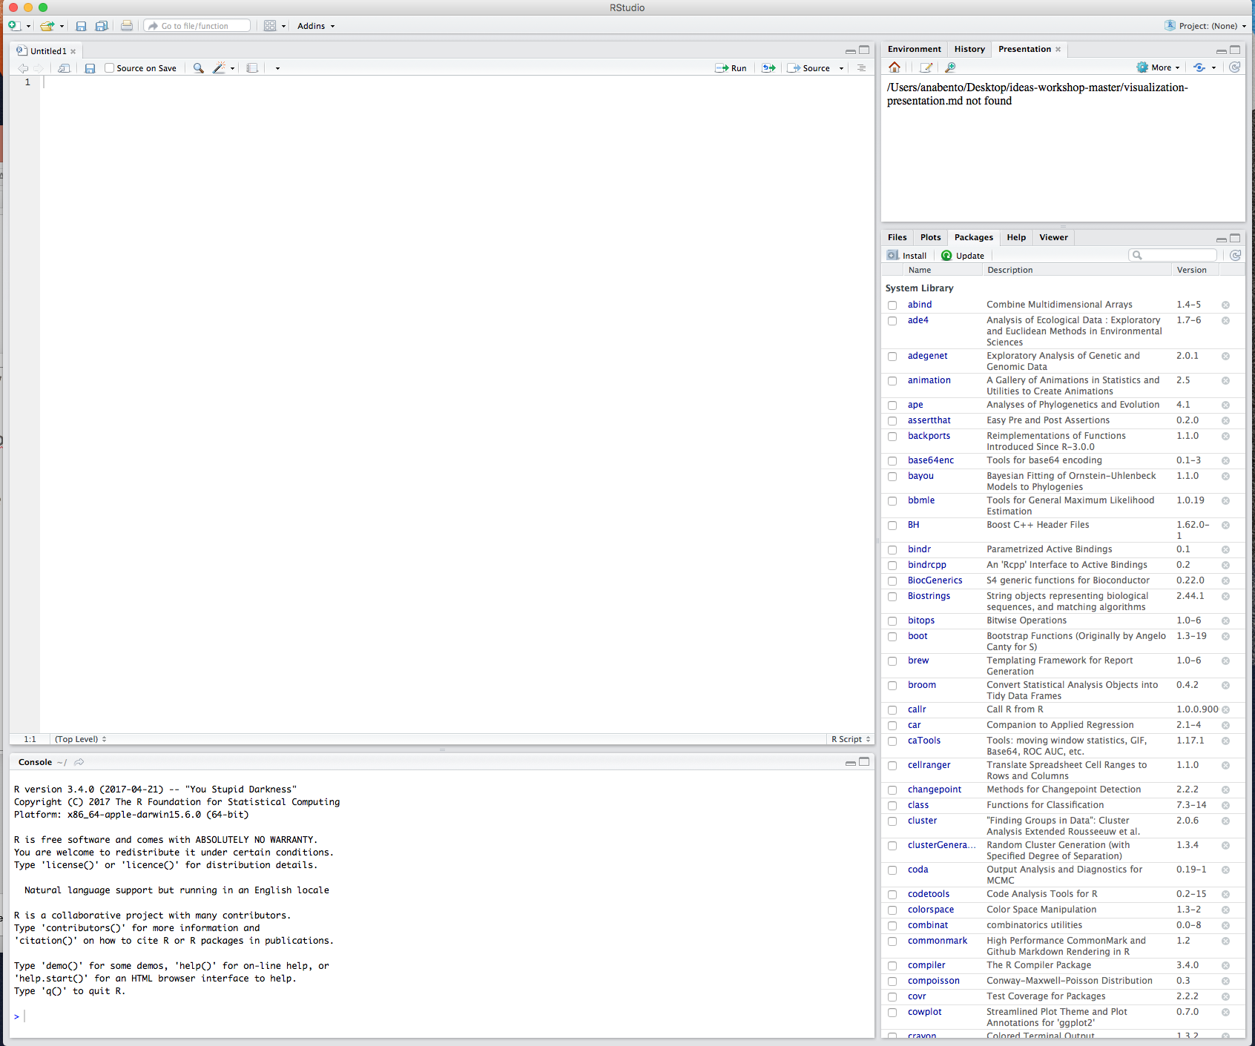
Using R is easier with RStudio
Cross platform application
Download it here: https://www.rstudio.com/products/rstudio/download
Lets open RStudio!
Notes:
It's free!
Popularity -- we can show published papers with plots
Awesome power
can handle complex and large data
can easily program complex simulations
can be used on High Performance Computer Clusters * supports multicore task distribution* Flexibility* Great support * Packages vignettes, tutorials, free books * StackOverflow * R-Bloggers
1

Slide 19
When we first start we have 3 panes: The console (the brain)
The environment & history
Files, plots packages help
The environment and history
Files, plots packages help
The console
Notes:
Here have them type some basic operations and make a variable assignment!
1

Slide 20
Creating a new project

Slide 21
File →Project →New directory (a folder that RStudio will create)

Slide 22
File →Project →New directory (a folder that RStudio will create)
Empty Project → Name the directory and place it where you want (subdirectory of)

Slide 23
File →Project →New directory (a folder that RStudio will create)
Empty Project → Name the directory and place it where you want (subdirectory of)
The folder you created will be used to store all data related to your project

Slide 24
File →Project →New directory (a folder that RStudio will create)
Empty Project → Name the directory and place it where you want (subdirectory of)
The folder you created will be used to store all data related to your project
Including R workspace files, RStudio script files, data files (e.g., csv files), and custom functions

Slide 25
File →Project →New directory (a folder that RStudio will create)
Empty Project → Name the directory and place it where you want (subdirectory of)
The folder you created will be used to store all data related to your project
Including R workspace files, RStudio script files, data files (e.g., csv files), and custom functions
Each independent project that you undertake in R should be organized in a separate folder that contains everything you need for it

Slide 26
R packages

Slide 27
R’s functionality is distributed among many packages
Notes:
It's free!
Popularity -- we can show published papers with plots
Awesome power
can handle complex and large data
can easily program complex simulations
can be used on High Performance Computer Clusters * supports multicore task distribution* Flexibility* Great support * Packages vignettes, tutorials, free books * StackOverflow * R-Bloggers
1

Slide 28
R’s functionality is distributed among many packages
e.g. stats package contains functions for statistical methods
Notes:
It's free!
Popularity -- we can show published papers with plots
Awesome power
can handle complex and large data
can easily program complex simulations
can be used on High Performance Computer Clusters * supports multicore task distribution* Flexibility* Great support * Packages vignettes, tutorials, free books * StackOverflow * R-Bloggers
1

Slide 29
R’s functionality is distributed among many packages
e.g. stats package contains functions for statistical methods
When you download R you get a set of base packages
Notes:
It's free!
Popularity -- we can show published papers with plots
Awesome power
can handle complex and large data
can easily program complex simulations
can be used on High Performance Computer Clusters * supports multicore task distribution* Flexibility* Great support * Packages vignettes, tutorials, free books * StackOverflow * R-Bloggers
1

Slide 30
R’s functionality is distributed among many packages
e.g. stats package contains functions for statistical methods
When you download R you get a set of base packages
You can download and install add-on packages in a variety of ways
Notes:
It's free!
Popularity -- we can show published papers with plots
Awesome power
can handle complex and large data
can easily program complex simulations
can be used on High Performance Computer Clusters * supports multicore task distribution* Flexibility* Great support * Packages vignettes, tutorials, free books * StackOverflow * R-Bloggers
1

Slide 31
R’s functionality is distributed among many packages
e.g. stats package contains functions for statistical methods
When you download R you get a set of base packages
You can download and install add-on packages in a variety of ways
Using the Packages tab in Rstudio (download devtools)
Notes:
It's free!
Popularity -- we can show published papers with plots
Awesome power
can handle complex and large data
can easily program complex simulations
can be used on High Performance Computer Clusters * supports multicore task distribution* Flexibility* Great support * Packages vignettes, tutorials, free books * StackOverflow * R-Bloggers
1

Slide 32
R’s functionality is distributed among many packages
e.g. stats package contains functions for statistical methods
When you download R you get a set of base packages
You can download and install add-on packages in a variety of ways
Using the Packages tab in Rstudio (download devtools)
Using the command line install.packages(“ggplot2”)
Notes:
It's free!
Popularity -- we can show published papers with plots
Awesome power
can handle complex and large data
can easily program complex simulations
can be used on High Performance Computer Clusters * supports multicore task distribution* Flexibility* Great support * Packages vignettes, tutorials, free books * StackOverflow * R-Bloggers
1

Slide 33
R’s functionality is distributed among many packages
e.g. stats package contains functions for statistical methods
When you download R you get a set of base packages
You can download and install add-on packages in a variety of ways
Using the Packages tab in Rstudio (download devtools)
Using the command line install.packages(“ggplot2”)
Using devtools install_github(”dgrtwo/gganimate")
Notes:
1

Slide 34
R Documentation

Slide 35
https://cran.r-project.org/web/packages/ggplot2/index.html
Notes:
It's free!
Popularity -- we can show published papers with plots
Awesome power
can handle complex and large data
can easily program complex simulations
can be used on High Performance Computer Clusters * supports multicore task distribution* Flexibility* Great support * Packages vignettes, tutorials, free books * StackOverflow * R-Bloggers
1

Slide 36
https://cran.r-project.org/web/packages/ggplot2/index.html
Reference manual pdf
Notes:
It's free!
Popularity -- we can show published papers with plots
Awesome power
can handle complex and large data
can easily program complex simulations
can be used on High Performance Computer Clusters * supports multicore task distribution* Flexibility* Great support * Packages vignettes, tutorials, free books * StackOverflow * R-Bloggers
1

Slide 37
https://cran.r-project.org/web/packages/ggplot2/index.html
Reference manual pdf
Vignettes
Notes:
It's free!
Popularity -- we can show published papers with plots
Awesome power
can handle complex and large data
can easily program complex simulations
can be used on High Performance Computer Clusters * supports multicore task distribution* Flexibility* Great support * Packages vignettes, tutorials, free books * StackOverflow * R-Bloggers
1

Slide 38
https://cran.r-project.org/web/packages/ggplot2/index.html
Reference manual pdf
Vignettes
https://www.rdocumentation.org/packages/ggplot2/versions/2.2.1
Notes:
It's free!
Popularity -- we can show published papers with plots
Awesome power
can handle complex and large data
can easily program complex simulations
can be used on High Performance Computer Clusters * supports multicore task distribution* Flexibility* Great support * Packages vignettes, tutorials, free books * StackOverflow * R-Bloggers
1

Slide 39
https://cran.r-project.org/web/packages/ggplot2/index.html
Reference manual pdf
Vignettes
https://www.rdocumentation.org/packages/ggplot2/versions/2.2.1
Using the console to search for info on a specific function
e.g. ?read.csv or ??read.csv
Notes:
It's free!
Popularity -- we can show published papers with plots
Awesome power
can handle complex and large data
can easily program complex simulations
can be used on High Performance Computer Clusters * supports multicore task distribution* Flexibility* Great support * Packages vignettes, tutorials, free books * StackOverflow * R-Bloggers
1

Slide 40
Reproducibility

Slide 41
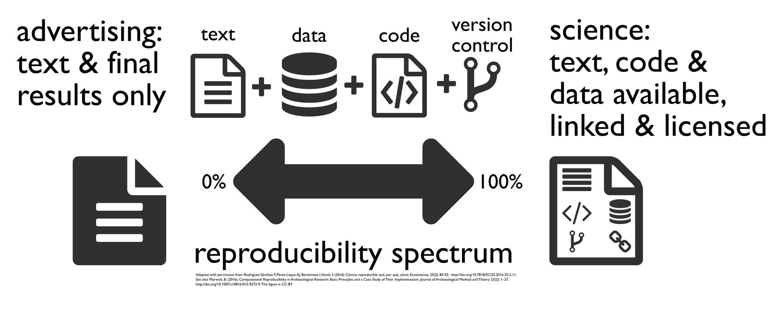
Notes:
It's free!
Popularity -- we can show published papers with plots
Awesome power
can handle complex and large data
can easily program complex simulations
can be used on High Performance Computer Clusters * supports multicore task distribution* Flexibility* Great support * Packages vignettes, tutorials, free books * StackOverflow * R-Bloggers
1

Slide 42
Goals

Slide 43
In this clinic you will develop a variety of useful skills for data manipulation and analysis in R:
Notes:
It's free!
Popularity -- we can show published papers with plots
Awesome power
can handle complex and large data
can easily program complex simulations
can be used on High Performance Computer Clusters * supports multicore task distribution* Flexibility* Great support * Packages vignettes, tutorials, free books * StackOverflow * R-Bloggers
1

Slide 44
In this clinic you will develop a variety of useful skills for data manipulation and analysis in R:
Write functions
Notes:
It's free!
Popularity -- we can show published papers with plots
Awesome power
can handle complex and large data
can easily program complex simulations
can be used on High Performance Computer Clusters * supports multicore task distribution* Flexibility* Great support * Packages vignettes, tutorials, free books * StackOverflow * R-Bloggers
1

Slide 45
In this clinic you will develop a variety of useful skills for data manipulation and analysis in R:
Write functions
Clean and manage data
Notes:
It's free!
Popularity -- we can show published papers with plots
Awesome power
can handle complex and large data
can easily program complex simulations
can be used on High Performance Computer Clusters * supports multicore task distribution* Flexibility* Great support * Packages vignettes, tutorials, free books * StackOverflow * R-Bloggers
1

Slide 46
In this clinic you will develop a variety of useful skills for data manipulation and analysis in R:
Write functions
Clean and manage data
Calculate summary statistics
Notes:
It's free!
Popularity -- we can show published papers with plots
Awesome power
can handle complex and large data
can easily program complex simulations
can be used on High Performance Computer Clusters * supports multicore task distribution* Flexibility* Great support * Packages vignettes, tutorials, free books * StackOverflow * R-Bloggers
1

Slide 47
In this clinic you will develop a variety of useful skills for data manipulation and analysis in R:
Write functions
Clean and manage data
Calculate summary statistics
Conduct statistical analyses
Notes:
It's free!
Popularity -- we can show published papers with plots
Awesome power
can handle complex and large data
can easily program complex simulations
can be used on High Performance Computer Clusters * supports multicore task distribution* Flexibility* Great support * Packages vignettes, tutorials, free books * StackOverflow * R-Bloggers
1

Slide 48
In this clinic you will develop a variety of useful skills for data manipulation and analysis in R:
Write functions
Clean and manage data
Calculate summary statistics
Conduct statistical analyses
Plot results
Notes:
It's free!
Popularity -- we can show published papers with plots
Awesome power
can handle complex and large data
can easily program complex simulations
can be used on High Performance Computer Clusters * supports multicore task distribution* Flexibility* Great support * Packages vignettes, tutorials, free books * StackOverflow * R-Bloggers
1

Slide 49
Today

Slide 50
Data Manipulation and exploration – Code Along
Navigating Data Types
Vectors
Matrices
Factors
Data frames
Lists
Writing and using Functions
syntax and examples of functions
control and logic statements
loops
summary stats
Data Manipulation and exploration – Review and Advanced Skills
Notes:
It's free!
Popularity -- we can show published papers with plots
Awesome power
can handle complex and large data
can easily program complex simulations
can be used on High Performance Computer Clusters * supports multicore task distribution* Flexibility* Great support * Packages vignettes, tutorials, free books * StackOverflow * R-Bloggers
1

Slide 51
Data Manipulation and exploration – Code Along
Navigating Data Types
Vectors
Matrices
Factors
Data frames
Lists
Writing and using Functions
syntax and examples of functions
control and logic statements
loops
summary stats
Data Manipulation and exploration – Review and Advanced Skills
Notes:
It's free!
Popularity -- we can show published papers with plots
Awesome power
can handle complex and large data
can easily program complex simulations
can be used on High Performance Computer Clusters * supports multicore task distribution* Flexibility* Great support * Packages vignettes, tutorials, free books * StackOverflow * R-Bloggers
1

Slide 52
Data Manipulation and exploration – Code Along
Navigating Data Types
Vectors
Matrices
Factors
Data frames
Lists
Writing and using Functions
syntax and examples of functions
control and logic statements
loops
summary stats
Data Manipulation and exploration – Review and Advanced Skills
Notes:
It's free!
Popularity -- we can show published papers with plots
Awesome power
can handle complex and large data
can easily program complex simulations
can be used on High Performance Computer Clusters * supports multicore task distribution* Flexibility* Great support * Packages vignettes, tutorials, free books * StackOverflow * R-Bloggers
1

Slide 53
Data Manipulation and exploration – Code Along
Navigating Data Types
Vectors
Matrices
Factors
Data frames
Lists
Writing and using Functions
syntax and examples of functions
control and logic statements
loops
summary stats
Data Manipulation and exploration – Review and Advanced Skills
Notes:
It's free!
Popularity -- we can show published papers with plots
Awesome power
can handle complex and large data
can easily program complex simulations
can be used on High Performance Computer Clusters * supports multicore task distribution* Flexibility* Great support * Packages vignettes, tutorials, free books * StackOverflow * R-Bloggers
<number>

Slide 54
Tomorrow

Slide 55
Data visualization
basic
ggplot
plottly (interactive plots)
Data Wrangling
Statistical Analysis
Notes:
It's free!
Popularity -- we can show published papers with plots
Awesome power
can handle complex and large data
can easily program complex simulations
can be used on High Performance Computer Clusters * supports multicore task distribution* Flexibility* Great support * Packages vignettes, tutorials, free books * StackOverflow * R-Bloggers
<number>

